Slide 1

PROBLEM SPACE
Solution Deck
GROUP -10
Prarthana.E [ST1153]
Pritha Dey [ST1156]
Shravani Prasad [ST1171]
Vansh Daryani [ST1177]
Harshith.S [ST1166]
Sarthak Priyank Verma [ST1170]
30th September, 2024

Slide 2

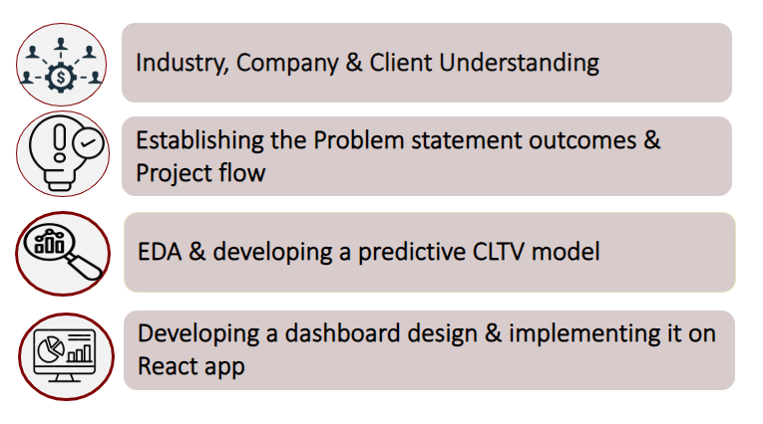
Agenda

Slide 3
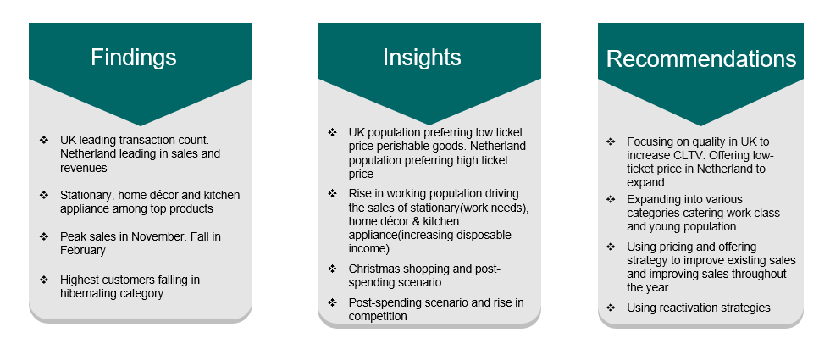
Executive Summary

Slide 4

Industry, Company and Client Understanding
Industry: Home Improvement Retail
Company: The Home Depot
Client: W Michael Planicka (Head of CRM team)
Key Takeaways:
Vertical Writeup
E-commerce Disruption: Transformed consumer shopping habits, challenging traditional retailers.
Omni-channel Expectations: Shifted businesses to integrate multiple shopping channels effectively.
Supply Chain Optimization: Rethink inventory and distribution to solve out-of-stock issues and boost efficiency.
Client Context
Global Home Improvement Leader: Holds 17% market share in the U.S. with 2,324 stores, reaching 90% of the population within 10 miles.
Home Improvement Market Growth: Projected to reach $1,012.9 billion by 2028, driven by smart home products and sustainable materials
Empathy Map
Versatile Expertise: Skilled in business intelligence and data analytics, leveraging insights to drive growth, operational performance, and sustainability initiatives.
Collaborative Leadership: Aiming for senior roles, emphasizes cross-departmental collaboration to deliver impactful solutions and foster innovation.

Slide 5
Establishing problem statement, Outcomes and Project workflow
Problem Statement:
The CRM team is facing challenges in maintaining customer loyalty and managing the costs of acquiring new customers. These challenges are impacting the company's profitability and long-term growth.
Expected Outcomes:
Enhanced Customer Retention: Increase the retention rate by implementing targeted strategies to engage and retain high-value customers.
Optimized Customer Acquisition: Reduce customer acquisition costs by focusing on acquiring customers who are likely to have a higher CLV
Increased Profitability: Improve overall profitability through a better balance of acquisition and retention efforts, ensuring sustainable growth

Slide 6
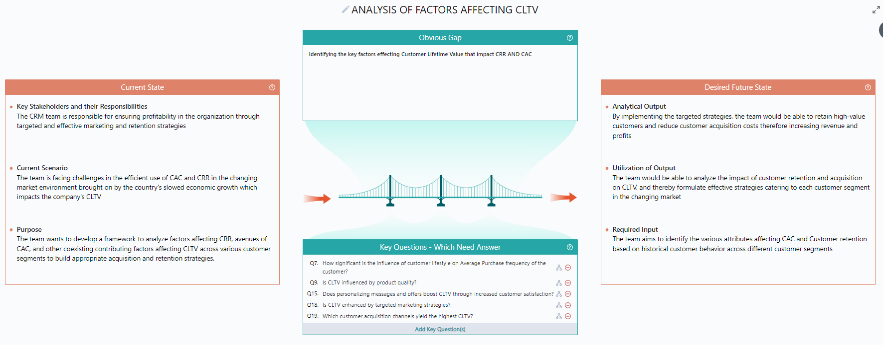
Mu PDNA

Slide 7
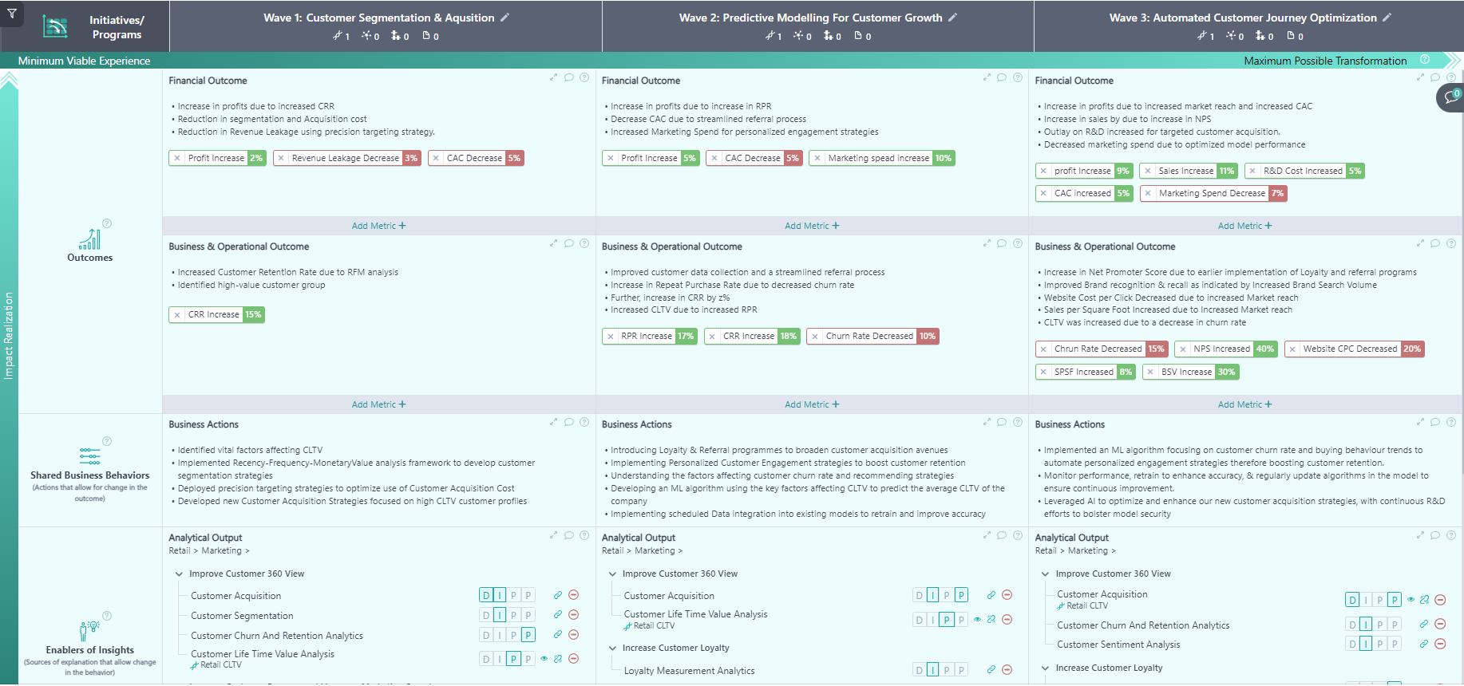
Mu OBI

Slide 8
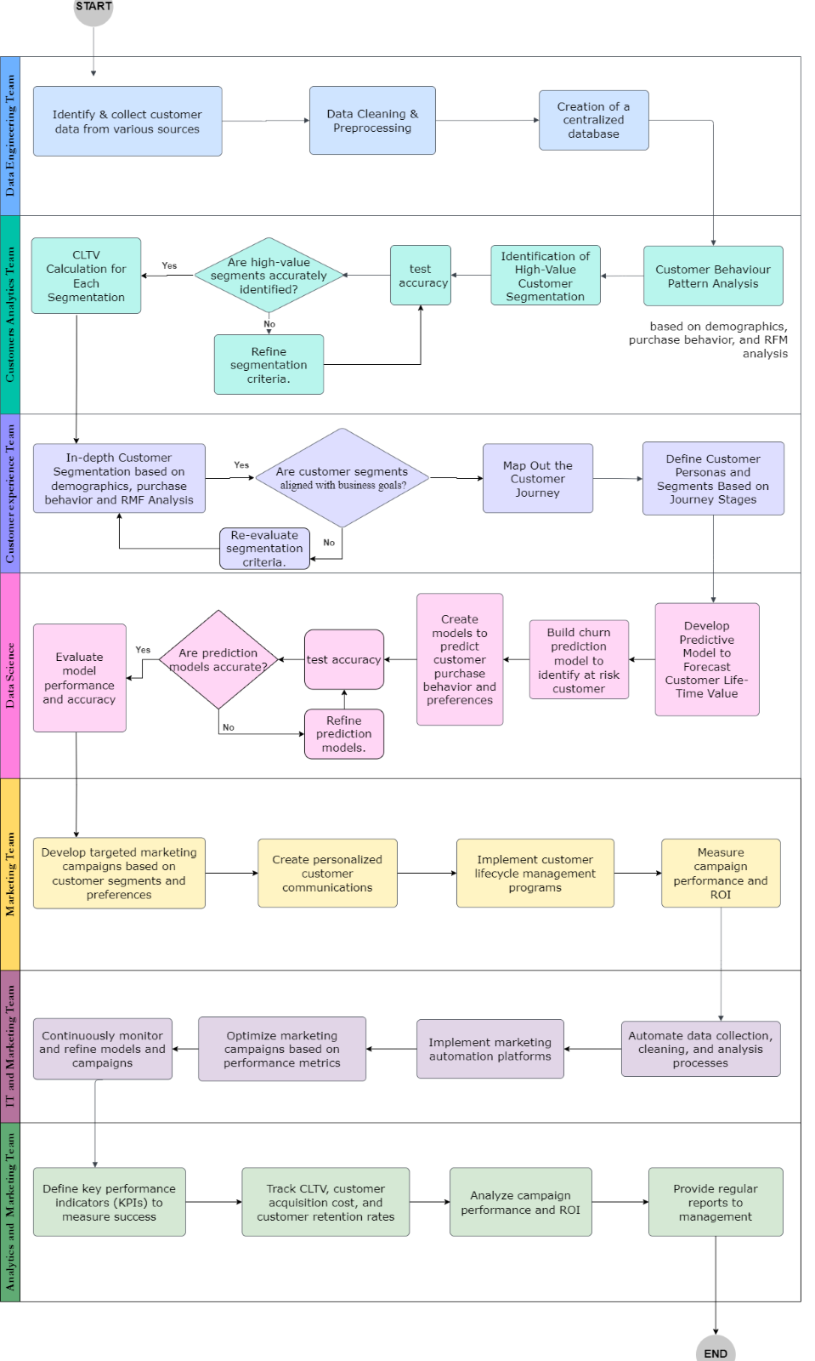
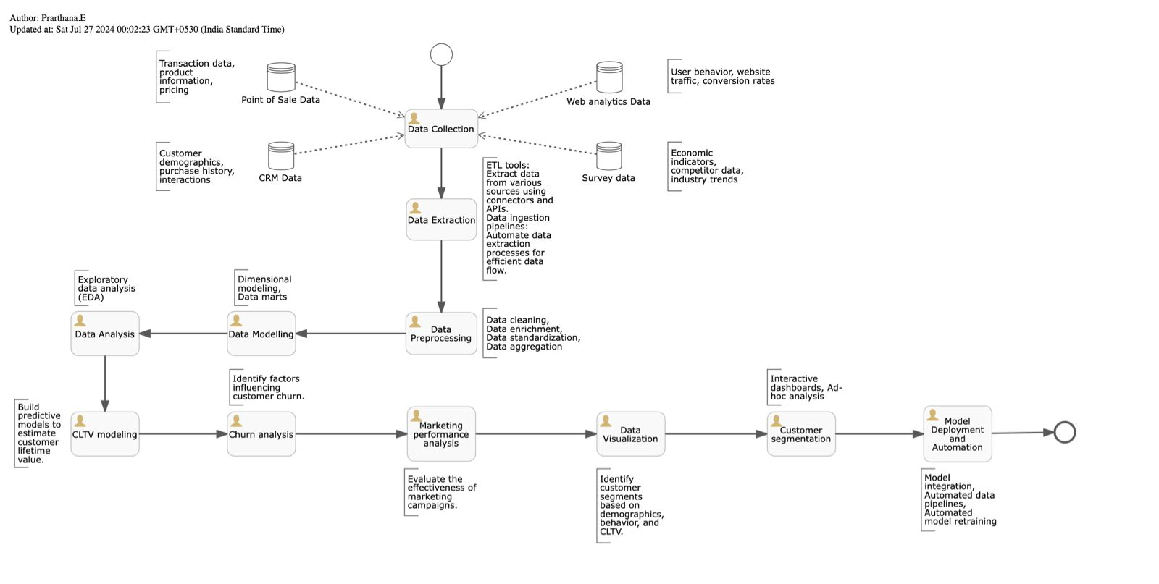
BPF and ADF

Slide 9
EDA and developing a predictive CLTV model
Key Takeaways from the EDA:
United Kingdom leads the count of transaction with 926039 transactions and highest sales of near $17,500,000
Customers prefer low ticket price products of $1-$25 and low bucket size over high ticket products and large bucket size
Low CLTV of 0-125 affected by factors like low purchase frequency, low AOV and high acquisition cost
Product stock code – 84077 is the flagship product with sales over 103,436. Stationary, Kitchen and Home décor among highest selling categories
“Hibernating” category stands at 1501, highest, signaling retention and reactivation strategies
Holistic strategy implementation to retain old customers, attract hibernating customers and acquire new customers
Key Takeaways from Data Modelling:
Target variable: cltv
Predictor variables: total_transaction, total_price, purchase_frequency and customer_value
Model Chosen: Random Forest
Justification: Random Forest, with its high R² score of 0.9494 (meaning it explains approximately 95% of the variance in CLTV), low MAE of 6211.6992 and RMSE of 122819.5091, and robustness, was chosen as the optimal model for predicting CLTV due to its ability to accurately capture patterns in the data and provide reliable predictions.

Slide 10
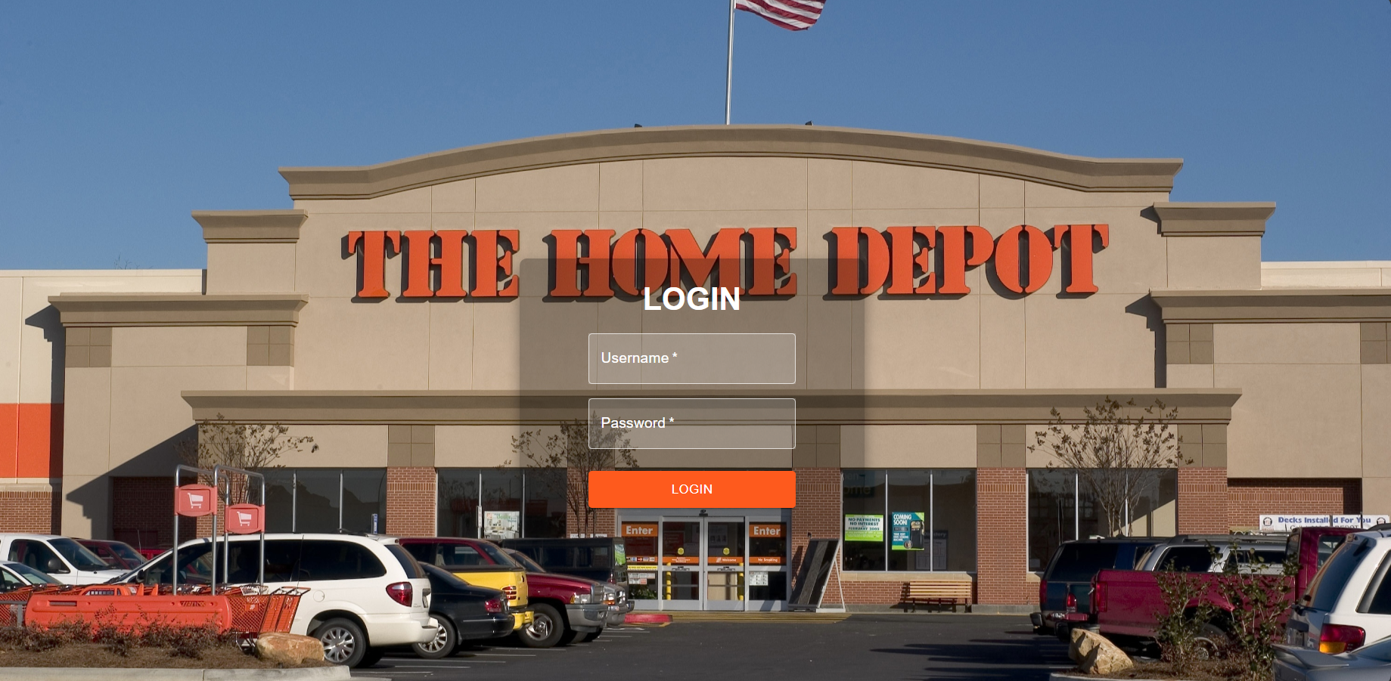
React Webapp – Final Dashboard
Page 1(Login Page)

Slide 11
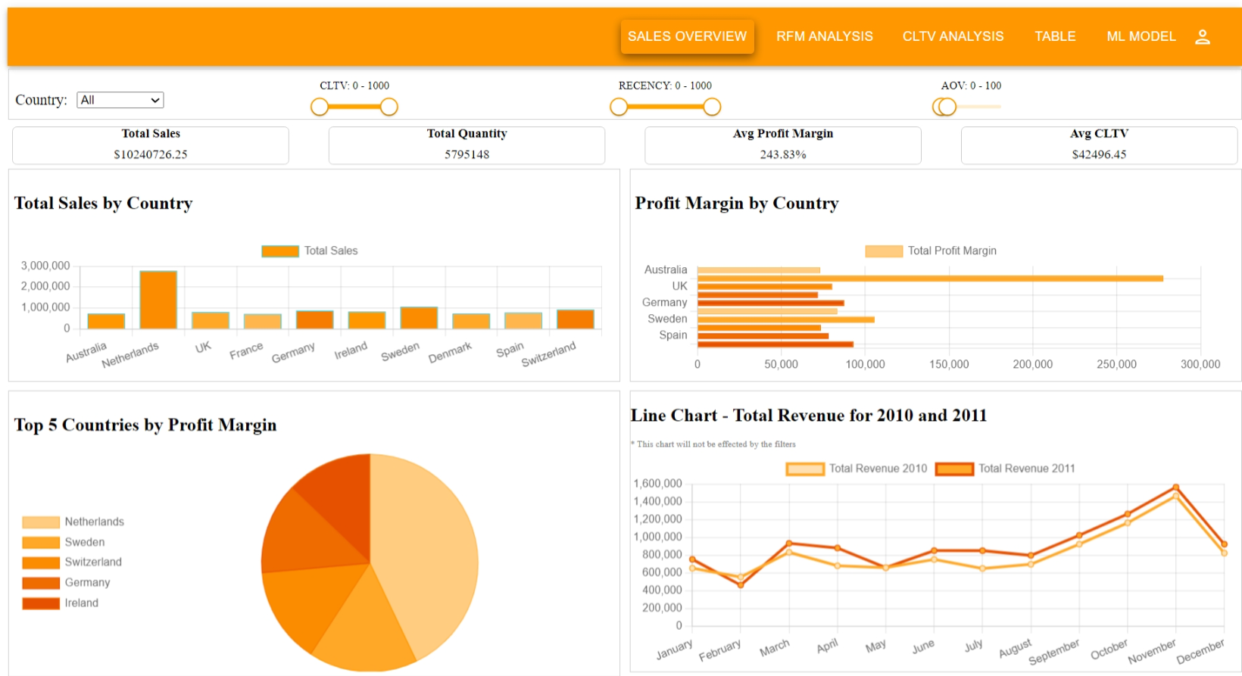
Page 2 (Sales Overview)

Slide 12
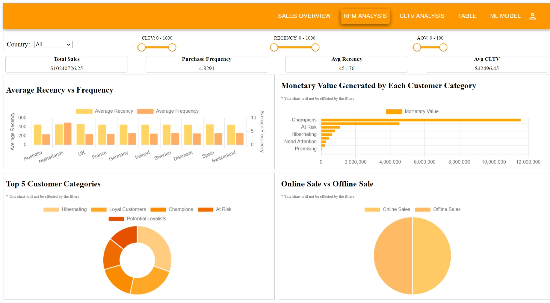
Page 3 (RFM Analysis)

Slide 13
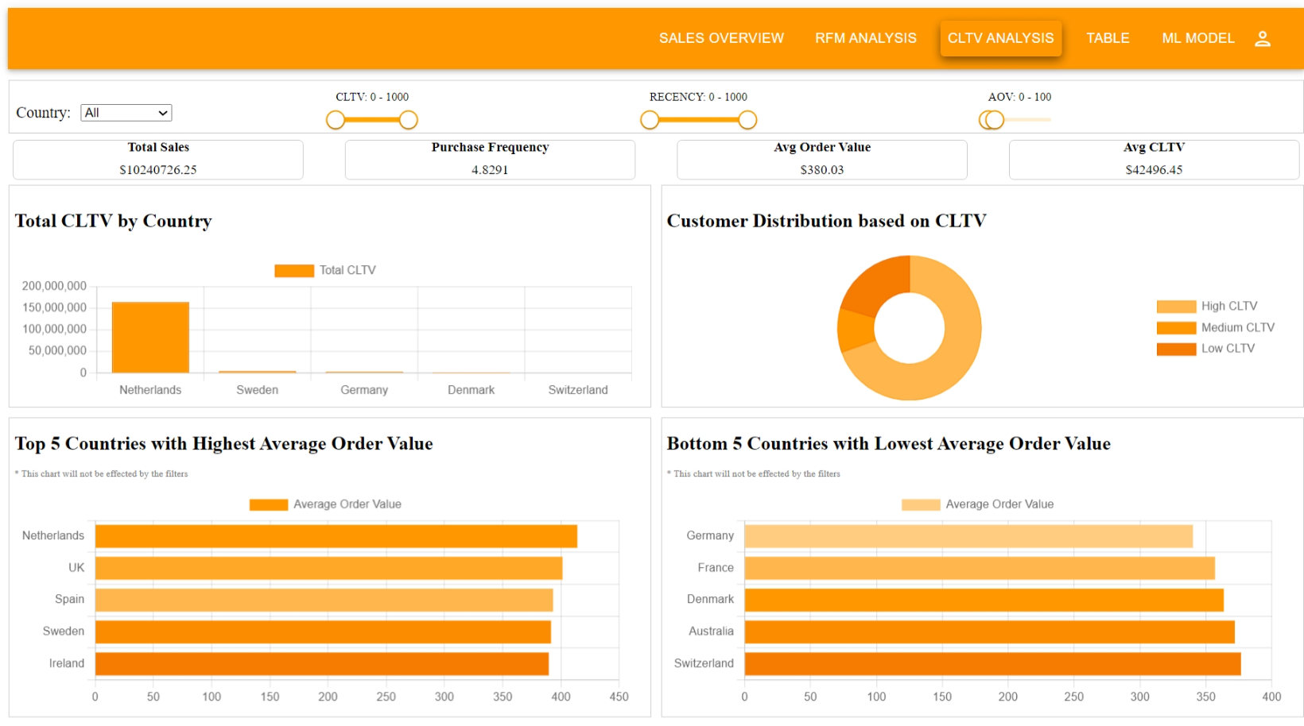
Page 4 (CLTV Analysis)

Slide 14
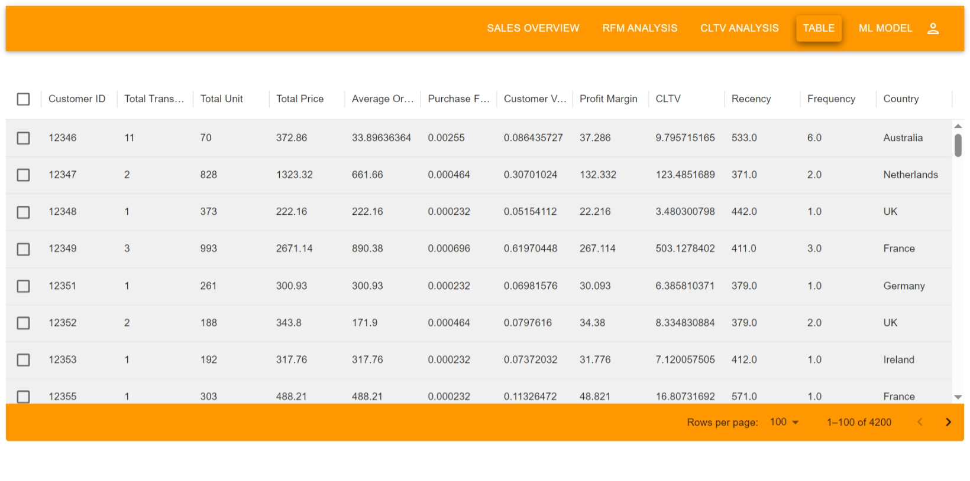
Page 5 (Data Table View)

Slide 15
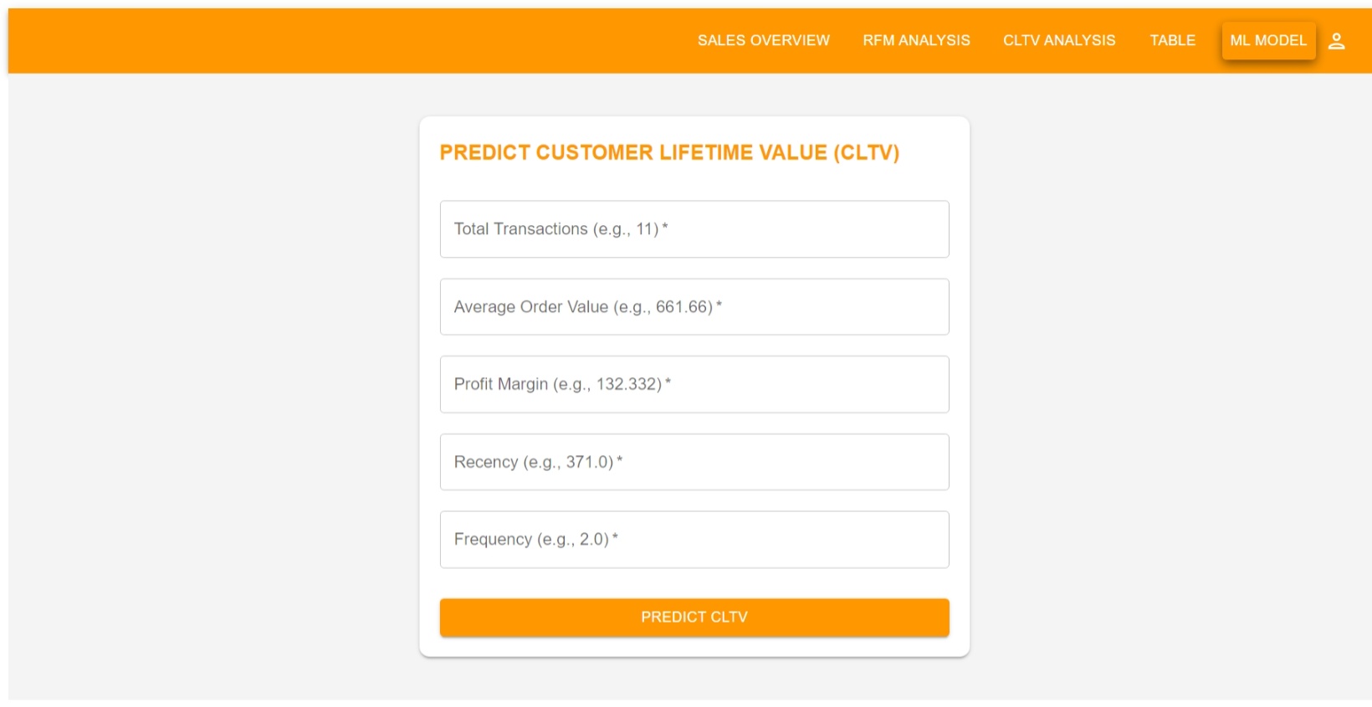
Page 6 (ML Model to predict CLTV)

Slide 16
Key Findings from EDA and Dashboard
High number of transactions in UK
The United Kingdom leads with the highest number of transactions (926,039) and total sales near $17.5 million.
Low Ticket Price Preferences
Customers prefer low-priced products ranging from $1 to $25, with low basket sizes.
Low CLTV
A large portion of customers has a low Customer Lifetime Value (CLTV), with many showing low purchase frequency and Average Order Value (AOV), leading to suboptimal profitability.
Top Performing Products
Stationery, Kitchen, and Home Décor products are among the best sellers, with stock code 84077 being the flagship product with sales over 103,436.
“Hibernating” Customers
A significant portion of the customer base falls into the "hibernating" category (1,501 customers), signaling potential for reactivation strategies.
Netherlands Leads in Profit and CLTV
The Netherlands ranks highest in total sales, profit margin, and CLTV, outperforming other regions.
Seasonal Sales Patterns
November consistently shows peak sales, while February experiences the lowest. There is an overall increase in revenue from 2010 to 2011.
Online vs Offline Sales
The sales distribution is nearly even, with 51% from offline channels and 49% from online.

Slide 17
Key Insights from EDA and Dashboard
High transactions and Low CLTV in the UK
Despite leading in number of transactions, the UK's low CLTV is driven by low-frequency purchases and a preference for
low-ticket items, which negatively impacts long-term profitability.
Customer Retention Opportunities
The large number of “hibernating” customers presents an opportunity for retention and reactivation strategies, which could significantly improve CLTV.
Impact of Product Preferences on CLTV
Customers' preference for low-ticket products results in a lower average order value (AOV), affecting profitability. Focusing on increasing the value per transaction could boost overall CLTV.
Country-Specific Variations
The Netherlands outperforms in terms of CLTV and profit margin, likely due to higher AOV and more frequent purchases, showcasing potential strategies for other markets.
Seasonality in Sales
Peak sales in November and drops in February and December suggest seasonal promotions, holidays, or clearance sales are driving these trends. The decline in December is more pronounced in 2011, which may relate to economic factors or
post-holiday slowdown.

Slide 18
Recommendations
Enhance Customer Retention Programs
Develop loyalty programs and personalized marketing efforts to target "hibernating" customers and re-engage them. Offering exclusive deals, personalized recommendations, and targeted outreach can help revive these customers.
Increase AOV and CLTV
Introduce bundling or upselling strategies to encourage customers to buy higher-value products. Focus on promoting
high-margin items or bundles that increase the total purchase value.
Leverage Regional Strengths
Use the success in the Netherlands as a model for other regions. Focus on replicating strategies in customer engagement, promotions, and product offerings that lead to higher CLTV and profitability.
Optimize Customer Acquisition
Refine marketing efforts to target high-CLTV customers, especially in regions with low AOV. Prioritize channels that yield
high-value customers to balance acquisition costs and customer lifetime value.
Seasonal Sales Optimization
Plan promotions around the strong sales in November and address the February dip with targeted campaigns or discounts. Consider strategies to retain momentum during the December post-holiday slump.
Online-Offline Integration
Given the near-equal distribution of online and offline sales, enhance omnichannel experiences by streamlining the customer journey across both platforms, ensuring consistency in offers and promotions to maintain sales across both segments.

